Slide 1
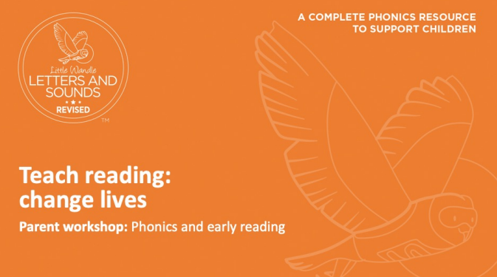

Slide 2

Introducing Little Wandle Letters and Sounds Revised
At the end of last year we introduced a new phonics and early reading programme called Little Wandle Letters and Sounds Revised. We chose LW as it closest to the Letters and Sounds program that our staff were used to delivering.
It is a government recommended phonics programme, which aims to ensure all children can fluently decode and read texts using phonics by the end of Year 1.
It is a complete systematic synthetic phonics programme (SSP) with a consistent approach that uses daily phonics teaching sessions, group reads along with catch-up/ keep-up interventions and half-termly assessments. All our staff have been trained in delivering this program.
Showing fidelity to this one scheme will ensure rigour, pace, parity and consistency across the school.
It is vital that you as parents/carers understand and support the school through this process as you play such a significant role in helping your child learn to read and develop a love of reading.

Slide 3
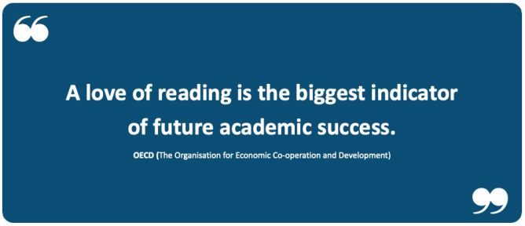

Slide 4
Research has shown that being able to read fluently by the age of 6 has a strong correlation with future academic success.
If children can read fluently, they are better able to access all areas of the curriculum.
‘If we learn to read, we can read to learn.’
Decoding using phonics is the most reliable method to work out unknown words which is why automatic decoding is the ultimate aim of the programme.

Slide 5
How we teach phonics

Slide 6
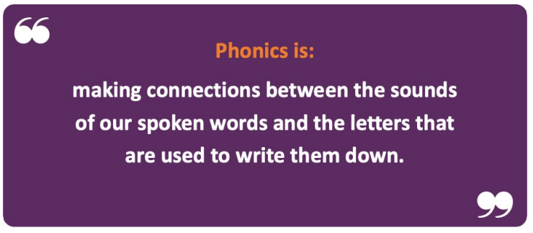

Slide 7
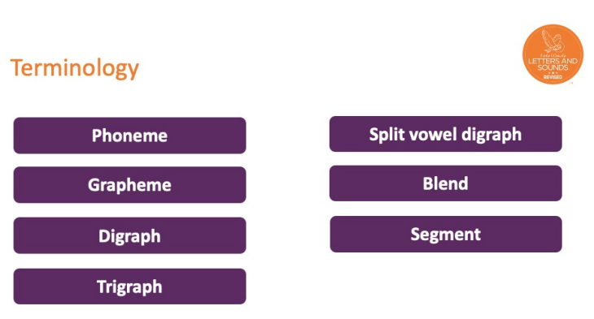

Slide 8
Phoneme
The smallest unit of sound that can be identified in words.
Grapheme
A letter or group of letters used to represent a particular phoneme when writing.
Digraph
Two letters that make one sound (phoneme) e.g. sh shop
Trigraph
Three letters that make one sound (phoneme) e.g. igh light
Split vowel digraph
A vowel sound where its two letters are split by a consonant
e.g. a_e make

Slide 9
Daily phonics sessions
  Revisit and review: The children will revise previous learning by recapping known phonemes, words and tricky words.
  Teach and practise: New phonemes, words and tricky words will be taught. The children will practise the new learning by blending to read words.
  Four new phonemes a week with a review on Fridays.
  Practise and apply: The children will apply their new learning by reading and/or writing words and sentences.
  Assess and review every 6 weeks

Slide 10
Pronouncing phonemes and blending
Correct pronunciation is vital in learning how to say sounds, so please take a look at the information video link to hear how phonemes are correctly said.
Information video link: https://www.littlewandlelettersandsounds.org.uk/resources/for-parents/
Blending is being able push phonemes together to read words. Some children learn to blend really quickly, and others take a little longer.

Slide 11
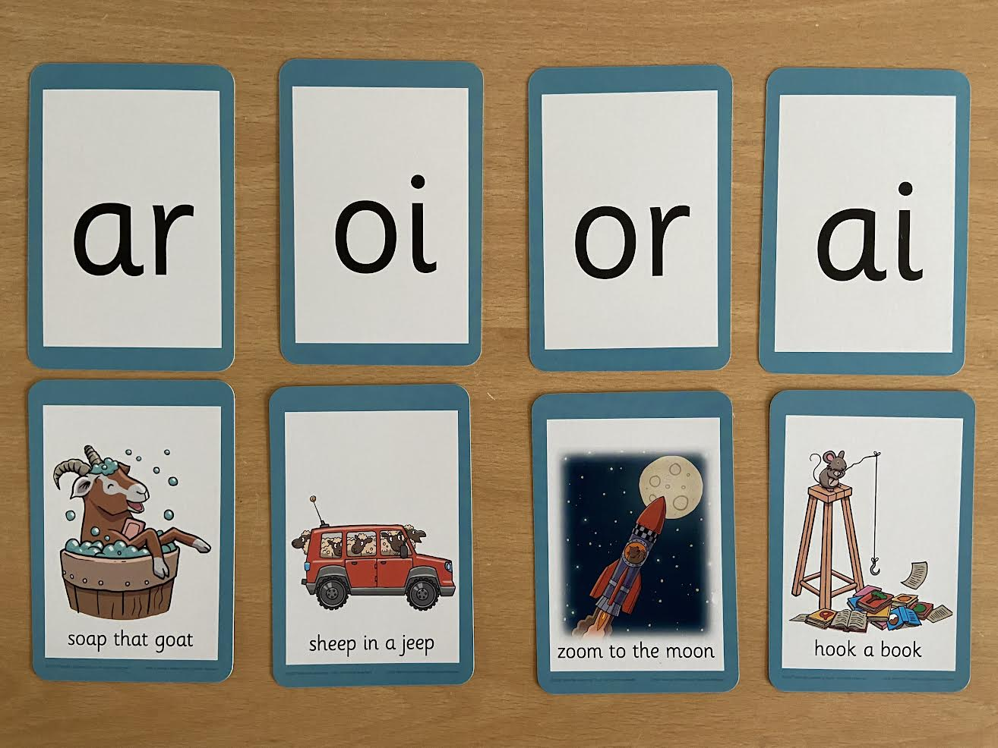
Notes:
Vowel digraphs taught with a short caption to help children remember
Also trigraphs igh, air

Slide 12
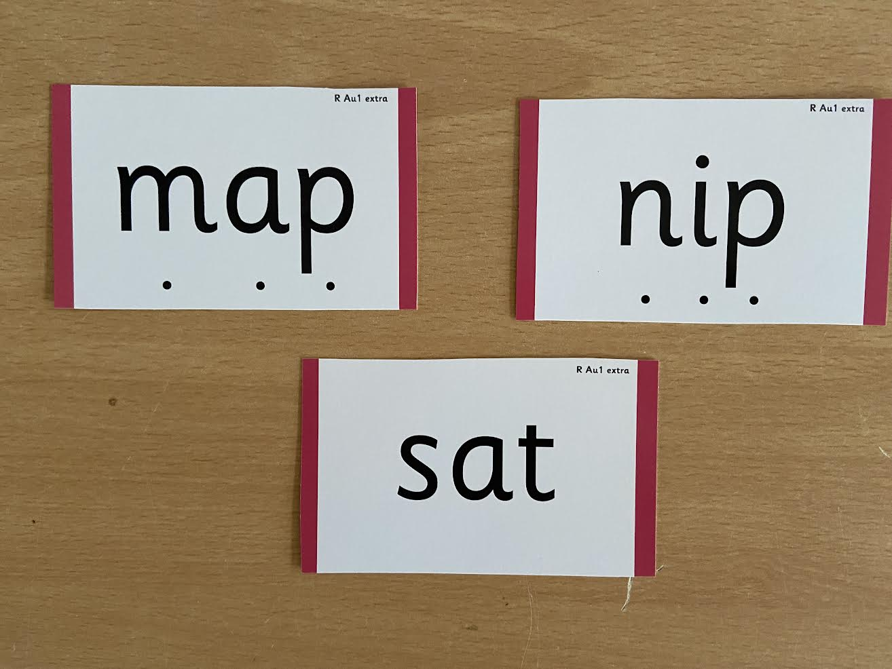
Notes:
During phonics lessons we use Sound buttons so we can sound talk and blend to read

Slide 13
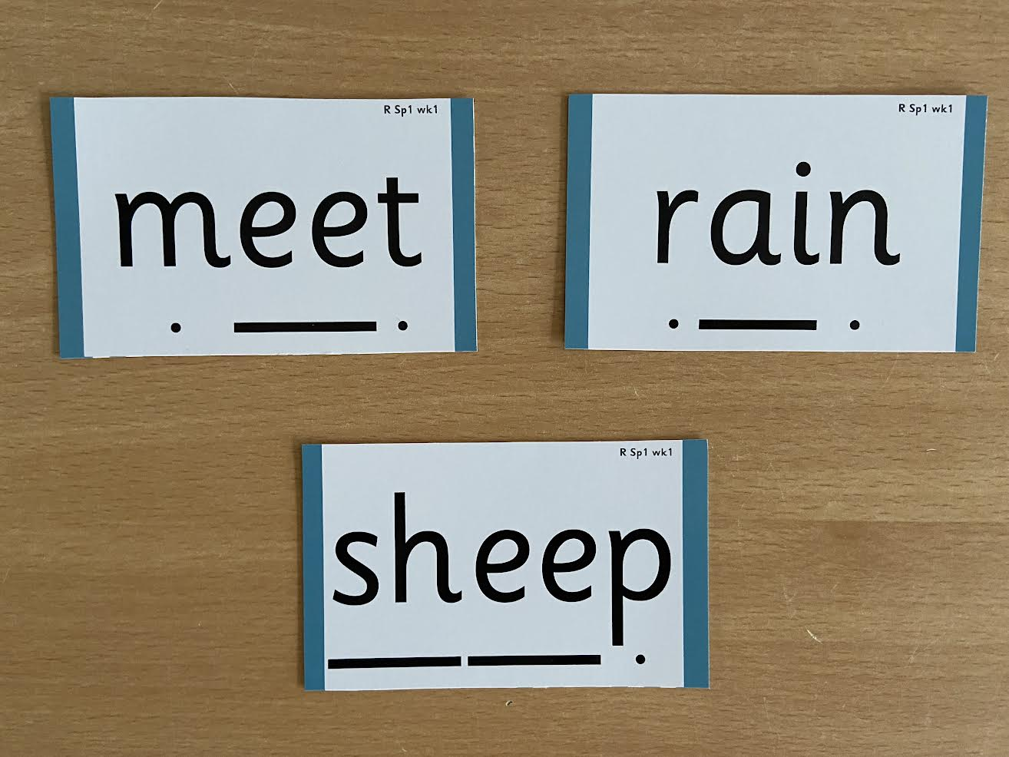
Notes:
Digraphs have a zip to sound talk and blend

Slide 14
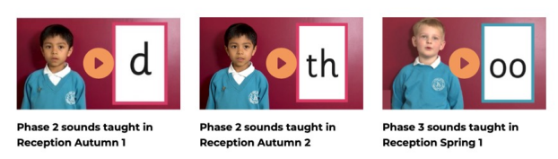
Pronunciation

Slide 15
Tricky words
High-frequency words that, although decodable in themselves, cannot be decoded by children using the GPCs they have been taught up to that point.
Examples: the go we of

Slide 16
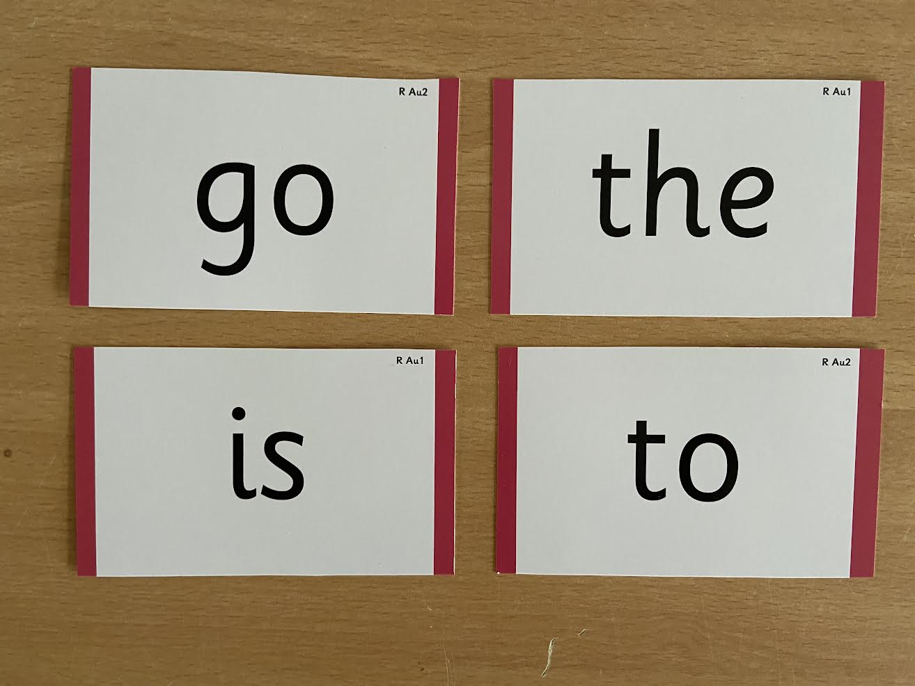
Notes:
Words that do not follow the rules and cannot be decoded – tricky words/ exception words
Chn are taught what part of the word is tricky

Slide 17
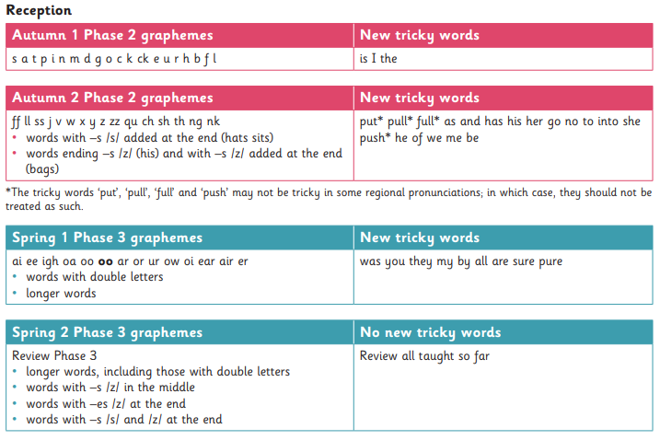
Programme progression
On the school website

Slide 18
What has changed?
Children will be expected to use phonics only to work out unknown words and must not be encouraged to guess or work out the word using other cues such as pictures.
In school, children will only be expected to read independently books that they can read at 90% fluency, this means that they only have to decode 1 word out of every 10.
At home, children will only be expected to read books that they can read with 90-95% fluency. These books will only contain graphemes and tricky words that they have already been taught.

Slide 19
How we teach reading

Slide 20
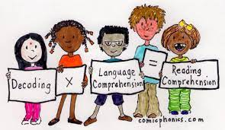
Reading Practice Sessions
Children will take part in three Reading Practice Sessions per week during which they will practise decoding, prosody and comprehension skills with a teacher or TA in a small group.
The first time we work on decoding (sounding out) the words.
The second time we work on prosody which is reading with intonation and expression – making the book sound more interesting with our storyteller voice or our David Attenborough voice.
The third time we look at comprehension.
We read the books three times at school because we want to develop the fluency. The more children see words, the more they begin to read them automatically without having to sound them out.

Slide 21
Supporting your child’s reading at home
Practice reading book
Children will be given a fully decodable book matched to their secure phonic knowledge each week. They will have read this book at school and will bring it home to read.
Sharing book – reading for pleasure
Children will also have a weekly sharing book for you to share and read to them.

Slide 22
Supporting your child’s reading at home
It may seem that the book your child has been given is too easy but the whole point is for them to develop their fluency and confidence using the graphemes and tricky words that they have been taught.
Your child should be able to read the practice book with developing confidence and fluency without any significant help. The front page helps you to know which phonemes and words are within the book.
Your role is to listen with interest and, most importantly, to encourage and praise, enthusiastically acknowledging the child’s achievement (even if, at the early stages, this is only small).
After the child has read the book, it may be helpful to talk about the book (using the back page as a prompt), but only so far as the child is interested. It is vital that you keep the reading experience positive and avoid turning it into a test.
Book bands: we will no longer use these to assign books. The books that children take home will be matched to their secure phonic knowledge.

Slide 23
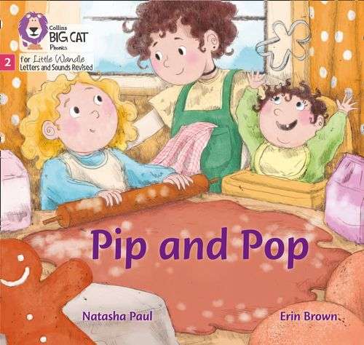
Reading Practice Book
This book has been carefully matched to your child’s current reading level. If your child is reading it with little help, please don’t worry that it’s too easy – your child needs to develop fluency and confidence in reading.
Listen to them read the book. Remember to give them lots of praise – celebrate their success! If they can’t read a word, read it to them. After they have finished, talk about the book together.
Books will be given out on a Friday to be read at the weekend and returned on a Monday morning.

Slide 24

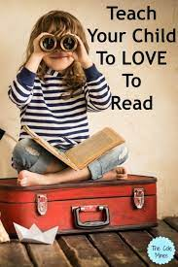
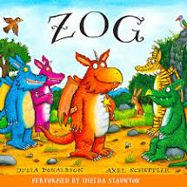

Sharing Book
In order to encourage your child to become a lifelong reader, it is important that they learn to read for pleasure. The sharing book is a book they have chosen for you to enjoy together.
Please remember that you shouldn’t expect your child to read this alone. Read it to or with them. Discuss the pictures, enjoy the story, predict what might happen next, use different voices for the characters, explore the facts in a non-fiction book. The main thing is that you have fun!

Slide 25
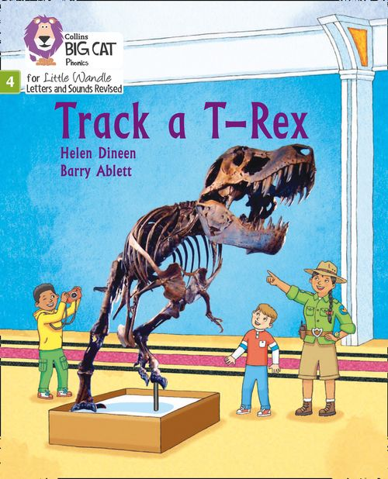

Returning books
It is vital that you return your child’s reading book every Monday so we can reallocate books as required. There are a specific number of books in each set and just one missing book affects a whole group’s reading session and the progression of phonics teaching that week.
Please look after the books too, it is important that your child respects them and there is an obvious significant cost implication if we need to replace them.
Each child in Reception and Y1 will be given a book bag, specifically to keep their books safe and in good condition.

Slide 26
Reading Records
Please continue to comment and/or sign in your child’s Reading Record. This can be any book your child has enjoyed reading or listening to.
Teachers and Teaching Assistants trained in the program will listen to children read three times a week and write in their Reading Record once a week.

Slide 27
In summary…
There are two types of reading book that your child may bring home:
1) Reading Practice Book: This will be at the correct phonic stage for your child. They should be able to read this fluently and independently.
2) Sharing Book: Your child will not be able to read this on their own. This book is for you both to read and enjoy together.

Slide 28
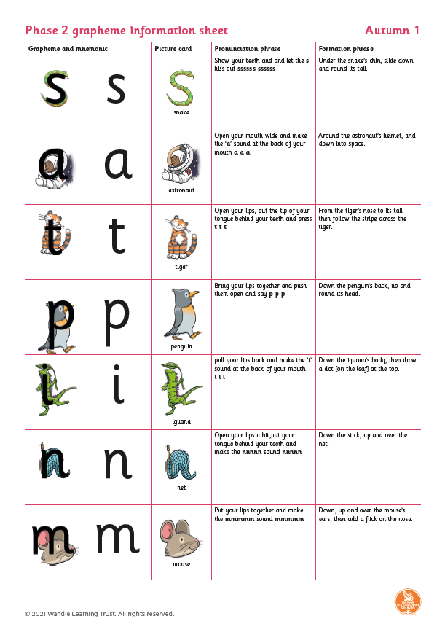
Further support
https://www.littlewandlelettersandsounds.
org.uk/resources/for-parents/
The school website will have the Little Wandle link, further information
and resource sheets from tomorrow.

Slide 29

We want children to take pleasure in opening and looking at books
We want children to love and enjoy reading
Reading underpins children’s access to the curriculum and clearly impacts on their achievement.
Learning to read should be a positive experience

