Slide 1
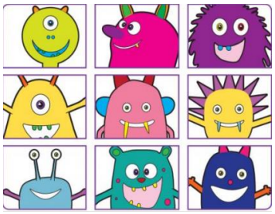
Year 1
Phonics Screening Check

Slide 2
What is phonics?
Children begin to learn phonics (sounds) in the Early Years.
Once children begin learning sounds, they use this knowledge to read and spell words. Children can then see the purpose of learning sounds. For this reason, the first initial sounds that are taught are s / a / t / p / i / n.
These can immediately be blended for reading (known as decoding), to make simple CVC words (consonant, vowel, consonant) e.g. sat, pin.
Children then develop segmenting for writing skills; breaking the words into sounds to spell it out

Slide 3
What is the Phonics Screening Check?
The phonics screening check is designed to confirm whether individual children have learnt sufficient phonic decoding and blending skills to an appropriate standard.
It helps teachers identify any misunderstandings or gaps in phonics knowledge before children move to Year 2.
Children in Year 1 are required to take part in the statutory national phonics screening check which is usually during the beginning of June.
Any children in Year 2 that did not pass the phonics screening check in Autumn, will also take part in the check again in June.

Slide 4
What happens during the screening check?
Miss Light as Y1 teacher, or Mrs Conway as English Lead, will sit individually with children in a quiet room to administer the screening check.
Children will be shown a list of words across 2 sections to read aloud.
The check takes approximately 10 minutes but it is not timed and children can work at their own pace.
Children can blend (sound out) words or read them by sight.
The list of words the children read is a combination of 20 real words and 20 pseudo words (nonsense words).

Slide 5

Pseudo Words
The pseudo words will be shown with a picture of an alien next to them. This provides the children with a context for the pseudo word which is independent from any existing vocabulary they may have.
Pseudo words are included because they will be new to all children; they do not favour children with a good vocabulary knowledge or visual memory of words.

Slide 6
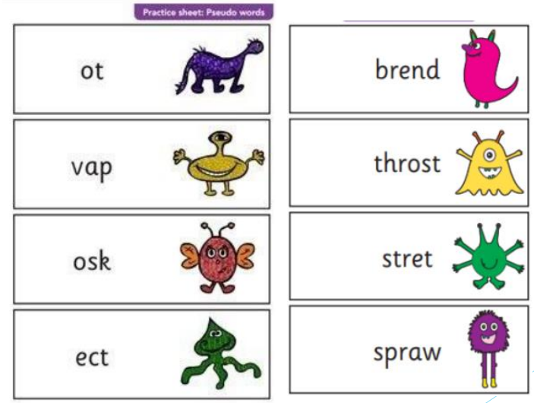

Slide 7
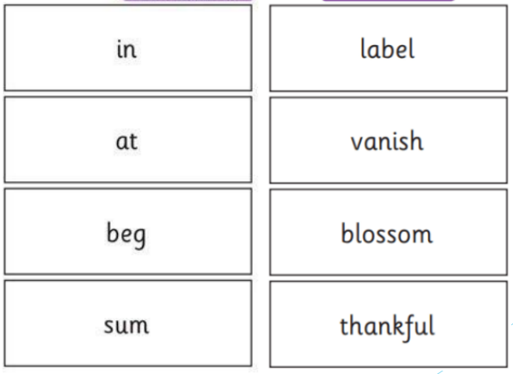
Real words

Slide 8
What is tested?
Section 1
The words in section 1 will have a variety of simple word structures (for example CVC, VCC, CCVC and CVCC) using:
single letters (a, b, c, d, e, f, g, h, I, j, k, l, m, n, o, p, q(u), r, s, t, u, v, w, x, y, z)
some consonant digraphs (ch, ck, ff, ll, ng, sh, ss, th, zz)
frequent and consistent vowel digraphs (ar, ee, oi, oo, or)

Slide 9
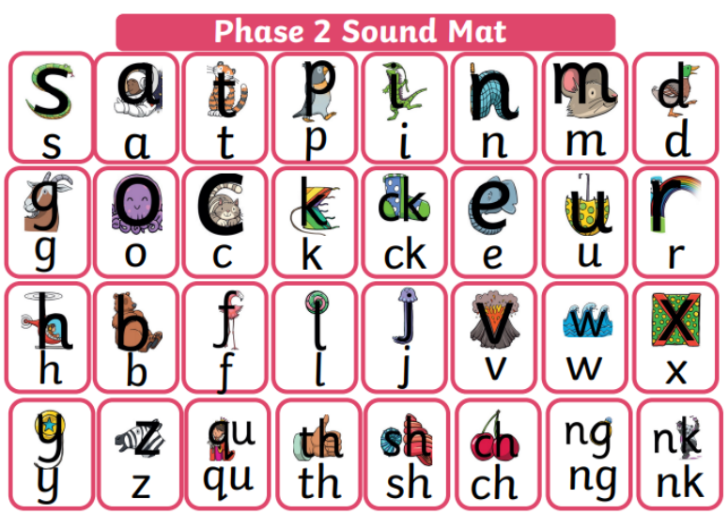

Slide 10
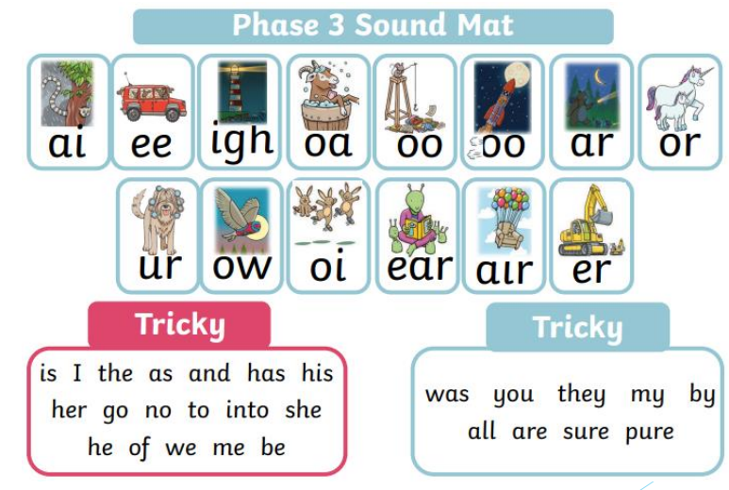

Slide 11
What is tested?
Section 2
The words in section 2 will have a variety of more complex word structures (for example CCVCC, CCCVC, CCCVCC and two syllable words) with some:
additional consonant digraphs (ph, wh)
less frequent and consistent vowel digraphs, including split digraphs (a-e, ai, au, aw, ay, ea, e-e, er, ew, i-e, ie, ir, oa, o-e, ou, ow, oy, ue, u-e, ur)
trigraphs (air, igh).

Slide 12
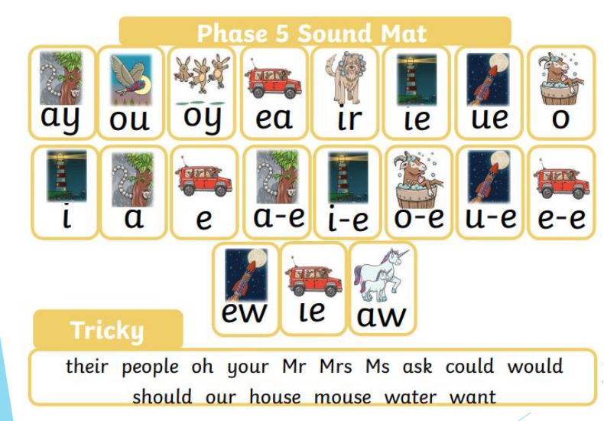

Slide 13
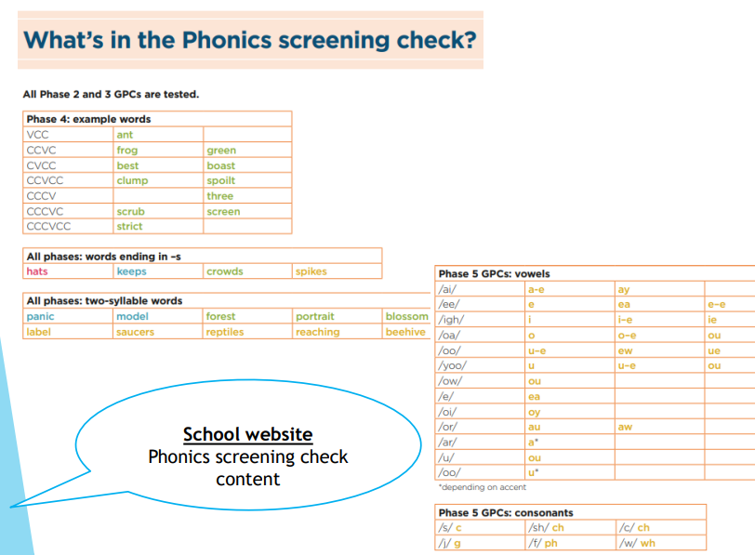

Slide 14
Results
We will report the result of the phonics screening check to parents at the end of the Summer term.
This will confirm if the child has met the standard threshold set by the government, resulting in a ‘pass’.
Children who do not achieve the expected level will retake the check in June of Year 2.
Children not working at the expected level, receive additional ‘keep up’ support to support them to make rapid progress in learning phonics.

Slide 15
How can parents help?
Please continue to listen to your child read and read to them.
If your child is struggling to read a word, encourage them to identify the phonemes in a word (individual sounds and digraphs).
As your child sounds out the phonemes from left to right, point to the letters as they read them aloud.
Discuss the meaning of words whilst reading.

Slide 16
Thank you
If you have any other questions regarding the phonics check, please contact your child’s teacher.

